Slide 1
Chapter 1: fundamental concepts of SDPM
Software Development project management - sdpm (Undergraduate)

Slide 2
What is a project?
A temporary (finite) group of related tasks undertaken to create a unique product, service, or result.
Key characteristics of a Project:
Non-routine tasks involved
Planning is required
Specific objectives are to be met or Specified product is to created
The product development has a predetermined time span (deadline)
Work is carried out for someone other than yourself
Work involves several specialism (area)
Work is carried out in several phases
The resources that are available for use on the project are constrained (controlled)
The project is large or complex

Slide 3
Software project
The process of making visible that which is invisible
Comparisons with other types of project:
Invisibility: When a bridge is being constructed the progress being made can actually be seen
Complexity: Software products contain more complexity (e.g. logical) than other engineered artifacts
Flexibility: The software systems are likely to be subject to a higher degree of change

Slide 4
Project management
Project Management uses skills, knowledge, and resources to satisfy project requirements
The Project Manager is:
Formally empowered to use organizational resources
In control of the project
Authorized to spend the project’s budget
Authorized to make decisions for the project

Slide 5
Software Project management activities
The Feasibility Study
Investigation to decide whether a prospective project is worth starting
Planning
Guidance to execute, monitor, and control a project
Project Execution
The implementation of a projects

Slide 6
Process & Phases
Software Process:
Defines all the tasks required for developing and maintaining software
Software Process Phases:
The activities of a software process are termed as phases

Slide 7
Typical software project lifecycle
Requirement Analysis
Specification/Design/Modelling
Development/Coding
Testing
Implementation/Installation/Deployment
Maintenance and support
Documentation

Slide 8
Software project categories
Information systems vs. embedded systems
Information system interfaces with the organizations
Embedded system interfaces with a machine
Objectives vs. Products
Projects may be distinguished by whether their aim is to produce a product (client specify requirements details) or to meet certain objectives (improve service level)

Slide 9
Type of systems
Systems, subsystems and environments (e.g. cashier’s workstation in a supermarket)
System: a set of interrelated parts (barcode scanner, keyboard, monitor, cash drawer)
Subsystem: part of a larger system
Environment:
Outside the system (actor)
Things that affect the system
System has no direct control (to the environment)
Open systems
Open systems interact with the environment
Nearly all systems are open

Slide 10
Type of systems
Sub-optimization
Where a subsystems works at optimum but have detrimental (damaging) effect on the overall system
Example: a system that uses machine resources efficiently but is very difficult to modify
Socio-technical systems
Project Manager (PM) needs to have both technical competence as well as the ability to interact persuasively with other people

Slide 11
What is management?
Involves the following activities:
Planning: deciding what is to be done
Organizing: making arrangements
Staffing: selecting right people for the job
Directing: giving instructions
Monitoring: checking on progress
Controlling: taking action to remedy hold-ups (a situation causes delay)
Innovating: coming up with new solutions
Representing: liaising (cooperate on matter of mutual concern) with users etc.

Slide 12
problems with software projects (Common)
Poor estimates and plans
Lack of quality standards and measures
Lack of guidance about making organizational decisions (e.g. priority)
Lack of techniques to make progress visible
Poor role definition – who does what
Incorrect success criteria (feasibility)

Slide 13
problems with software projects (others)
Inadequate specification of work
Management ignorance of IT
Lack of knowledge of application area
Lack of up-to-date documentation
Schedule slips
Lack of communication
Lack of commitment
Narrow scope of technical expertise
Changing regulatory, established, mandatory requirements
Changing software environment
Deadline pressure
Lack of quality control
Remote management
Lack of training

Slide 14
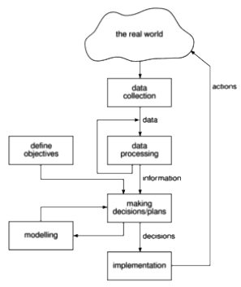
Management control
THE PROJECT CONTROL CYCLE:
MANAGEMENT is the process of setting objectives for a system and then monitoring the system to see what its true performance is

Slide 15
Management control
OBJECTIVES:
Project objectives should be clearly defined
For successful software project:
The manager must know what will constitute success
For more than one user group:
Project Authority needs to be identified
Project steering committee has overall responsibility for:
Setting, monitoring, and modifying objectives
Authorizing changes to the project objectives and resources
The committee is likely to contain user development and management representatives.

Slide 16
Management control
MEASURES OF EFFECTIVENESS:
Effective objectives are concrete and well defined
Measure of effectiveness tell us how successful the project has been
The measure can, in some cases, be an answer to simple yes/no question
Example: ‘to reduce customer complaints by 50%’ would be more satisfactory than ‘to improve customer relations’.

Slide 17
Management control
SUB-OBJECTIVES AND GOALS:
Objectives broken down into sub-objectives keep things manageable
Sub-objectives are also known as goals
GOALS: steps on the way to achieve an objective.
Requirements related to “Reliability” can use different measures to quantify the goal
Property | Measure
Reliability | Mean (indicate) time to failure Rate of failure occurrence Probability of failure

Slide 18
stakeholders
Different types of stakeholders might have different objectives and successful PM recognizes these different interests and reconciles (find a solution) them
The PM needs to be a good communicator and negotiator
Stakeholders are people who have a stake or interest in the project.
It is important that they be identified as early as possible, because PMs need to set up adequate communication channels with them right from the start.
Stakeholders might be:
Internal to the project team
under the direct managerial control of the project leader

Slide 19
stakeholders
External to the project team but in the same organization
Example:
assistance of the information management group
assistance of the users
The commitment of the people involved has to be negotiated
Totally external to the organization
Example:
customers/users who will benefit from the system that the project implements
contractors who will carry out work for the project

Slide 20
Requirement specification
Functional Requirements
define what the system that will be the end product of the project is to do
Quality Requirements
define how the system that will be the end product of the project is to do
Resource Requirements
define a record of how much the organization is willing to spend on the system
Tradeoff
Everybody likes exceptionally reliable and user-friendly systems with the exact required functionality but might be expensive

Slide 21
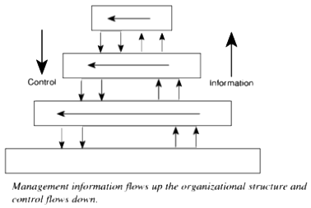
Information and control in organization

Slide 22
Information and control in organization
Levels of DECISION MAKING & INFORMATION:
Strategic Decision Making
essentially about deciding objectives
Tactical Decision Making
ensures that the objectives are fulfilled
Operational Decision Making
relates to the day-to-day work of implementing the project

Slide 23
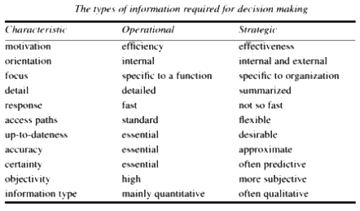
Information and control in organization
Differences In Types Of Information:
Effectiveness is concerned with doing the right thing.
Efficiency is carrying out a task making the best possible use of the resources

Slide 24
references
Bob Hughes and Mike Cotterel (1999). Software Project Management (Second Edition).

